Slide 1
How to be your own marketing team

Slide 2

Nice to meet you!
Jeremy Alexander
Digital Marketing Specialist, Paper Sword B2B
I help companies take their business goals and turn them into effective marketing strategies.
I’m also am personally responsible for those eerily targeted ads you see on the internet.

Slide 3
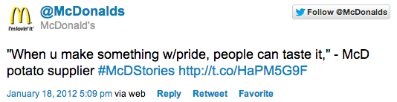
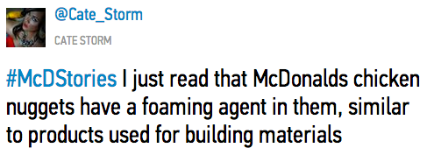
What Most People Think Marketing Is…

Slide 4

Marketing is so Much More
"the action or business of promoting and selling products or services”

Slide 5

Marketing is so Much More
“Marketing delivers standalone value for prospects through content, with the goal of demonstrating product value, strengthening brand loyalty, and ultimately increasing sales”

Slide 6
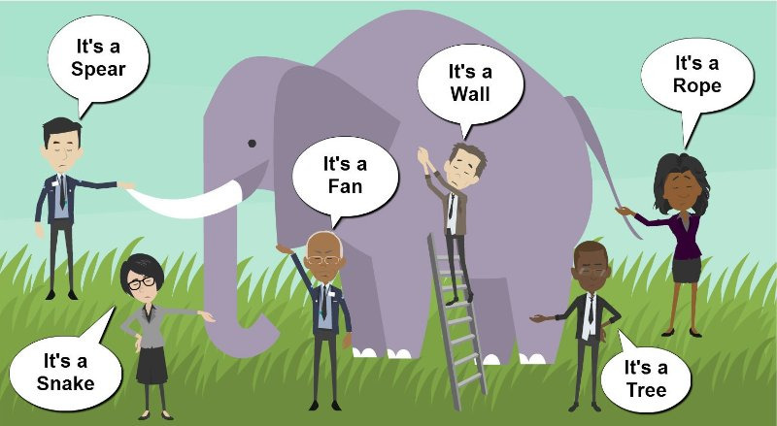
Most Marketers Don’t Know How Marketing Works.

Slide 7

Marketing is Made up of Many Moving Parts
“It's a marketer's job to convince you that their specific part of the system will be the silver bullet you need to get a steady stream of clients"–HubSpot Marketing
The types of marketing we’ll review in (somewhat) detail today are:
Messaging and Product Marketing
Social Media Marketing
Email Marketing
Search Engine Marketing
Marketing is like an engine. There’s lots of moving parts and diagrams attempting to explain it are confusing.

Slide 8

Why should I care about Marketing?

Slide 9
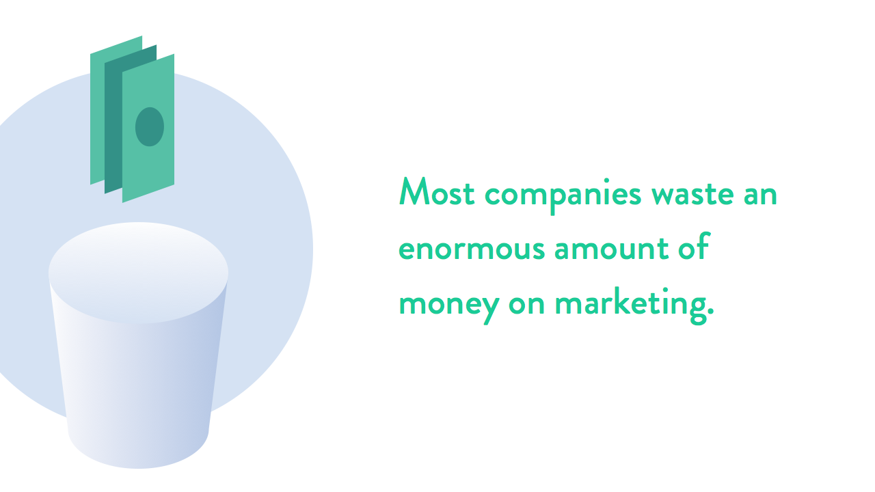

Slide 10

Messaging Best Practices

Slide 11
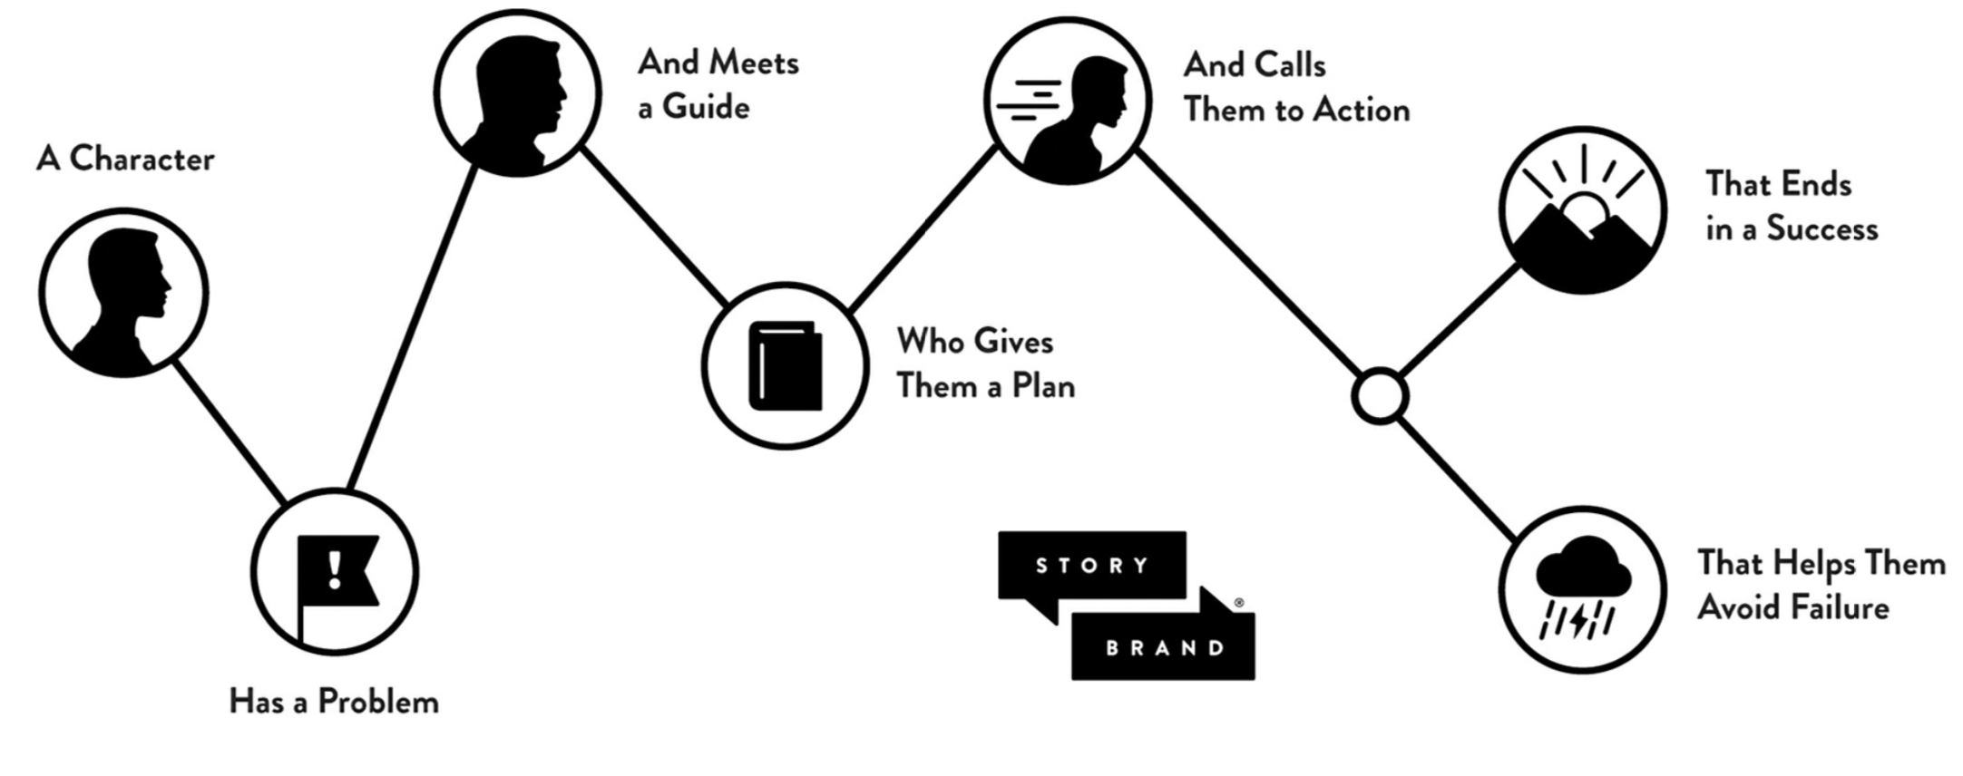
Finding the Right Message

Slide 12
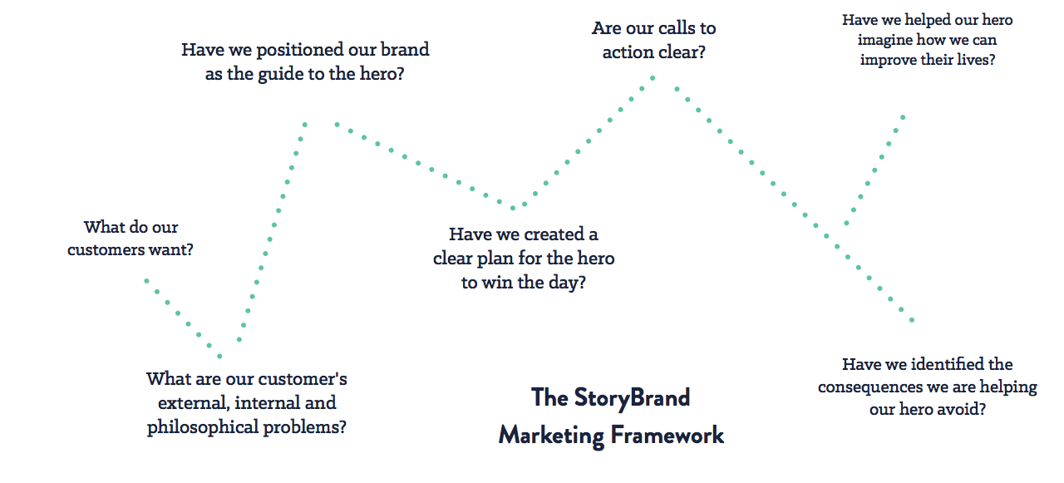

Slide 13
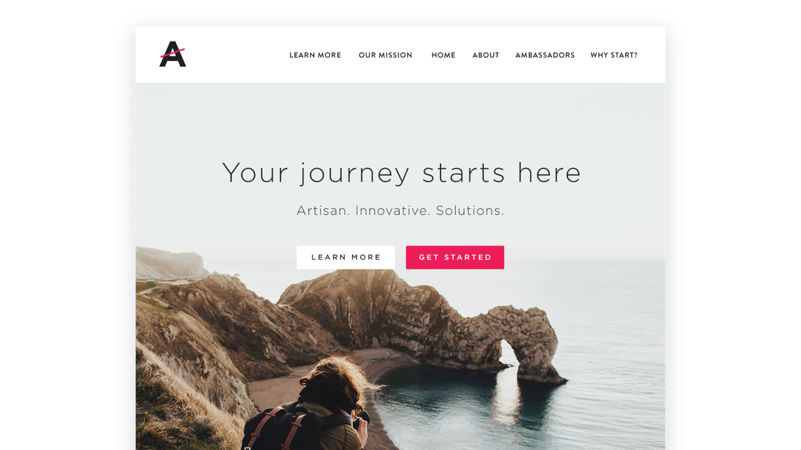
What do We Think of this Website?

Slide 14

Marketing isn’t just for marketers. EVERYONE needs to be involved!

Slide 15
Social Media Best Practices

Slide 16
Metrics, Metrics, Metrics!
Key Metrics to watch on social media are:
Impressions (How many people view your content)
Engagements (How many shares, likes, comments, and link clicks you get)
Engagement Rate (What percentage of users who engage with your content)
Where to access these metrics:
Twitter (Visit Analytics.Twitter.com while logged in, select the “tweets” submenu)
LinkedIn (Visit “Analytics” from your company page, select the “updates” submenu)
Facebook (Visit “Insights” from your company page, select the “posts” submenu)

Slide 17
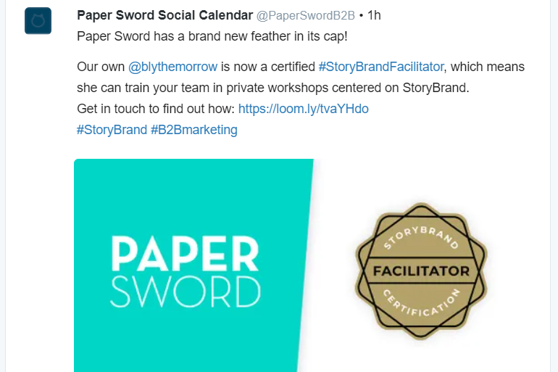
Social Media Content Phases
Awareness – Largely attained by using hashtags and user’s sharing your content, increases awareness of who you are, and what you do.

Slide 18
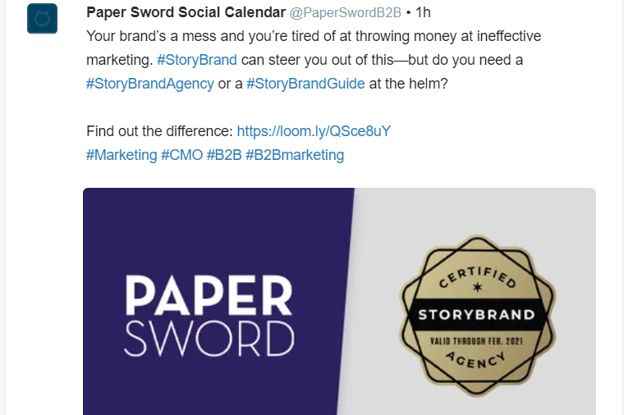
Social Media Content Phases
Consideration – Users who are in the consideration phase have either followed your page after finding you on social media, or are curious about the details of what your brand can offer them.

Slide 19
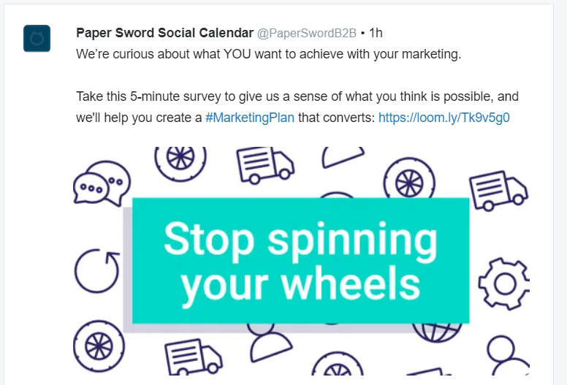
Social Media Content Phases
Conversion – Once users have built enough trust with your brand and had enough time to think over the collective value of working with you, they’ll be ready to convert to a customer… hopefully!

Slide 20
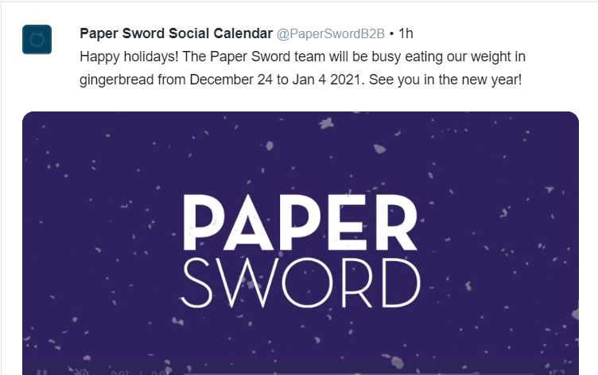
Social Media Content Phases
Retention – Now that you’re working with these users, you’ve got to make them happy.

Slide 21

Social Media Content Phases – Key Learnings
You need to cover all your bases on social media content creation.
Since each follower on your social media accounts follows you for different reasons, you need to produce content that appeals to each user month over month.
Just like you’re covering each phase of content creation, you should also make sure you’re covering a wide range of topics too.

Slide 22
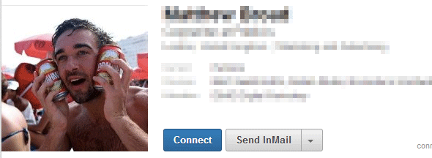
Putting Your Best Foot Forward on LinkedIn
Some key elements your profile must include are:
A recent, professional headshot of yourself
Updated work history
A solid bio and tagline for your profile
A cover image on your profile that promotes your business
A list of your skills with LOTS of endorsements! The best way to get these is to ask.
Try, if at all possible, to only pose with ONE BEER MAXIMUM

Slide 23

Putting Your Company’s Best Feets Forwards on LinkedIn
For your company page, we recommend adding the following as well:
A StoryBrand-style short-and-sweet company about section post-haste.
A jaw-dropping cover image that catches audience attention (you could design on Canva!)
Three tracked hashtags that relate most to your business
Your company location
A clear logo image as your profile picture
A link to your website in the “website” section

Slide 24
Email Marketing

Slide 25
Metrics, Metrics, Metrics!
Key Metrics to watch for email marketing are:
Open Rate (Total number of emails opened, Unique opens are how many users who opened)
Click Rate (Total number of emails clicked, Unique clicks are how many users who clicked)
Click-Through or Engagement Rate (Percentage of Users who Opened AND Clicked)
Deliverability Rate (How many emails made it to users’ inboxes. Should be >99% always)
Unsubscribe Rate (How many users got sick of getting your emails. Should be <.5% at most)

Slide 26


Email Marketing Fundamentals
AVOID SPAMMING PERSONALIZE CONTENT LET GO OF FAILING RELATIONSHIPS

Slide 27

Applying these Fundamentals – Avoiding Spam
Set a Content Schedule
Monitor Unsubscribes and Spam Complaints
Clean your Email Lists
Monitor Engagement Trends
Don’t Email too Often

Slide 28
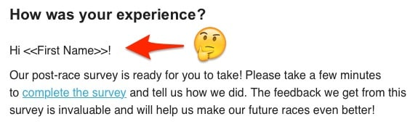
Applying these Fundamentals – Personalization
Personalization lets You Connect with Your Users
Good personalization is more than an auto-fill on their name or company
Use personalization to present them with content they enjoy

Slide 29

Applying these Fundamentals – Letting Go
Give Options for Your Email Marketing Subscription Types
Ask an Optional Exit Survey for Users who Unsubscribe
CLEAN. YOUR. EMAIL. LISTS. (It Bears Repeating)
Go for a Clean Breakup
Move on Quickly (But Not Too Quick)

Slide 30
SEO & Search Engine Marketing

Slide 31
Metrics to Watch and What They Mean
Users – Number of people who visited your website
Sessions – Number of times your website was visited by these users
Pageviews – The Number of pages users visit across each of their sessions
Session Duration – How long users visit your website on average
Bounce Rate – The percentage of users who leave the website without interacting
Keyword Ranking – How visible your website is on keywords you’re using
SEO – Marketing lingo for Search Engine Optimization, which is how visible you are on the web.

Slide 32

Increasing Your Website’s Visibility
There’s lots of SEO Audit Tools You Can Use for Free!
Make sure your website has Google Analytics and Google Search Console Added
Use Keyword-Focused Header Tags, Alt Tags, and Metadata
Use Keyword-Focused Blog Categories and Tags
Blog Often!! I recommend 2-3 Blogs/Month at Minimum

Slide 33


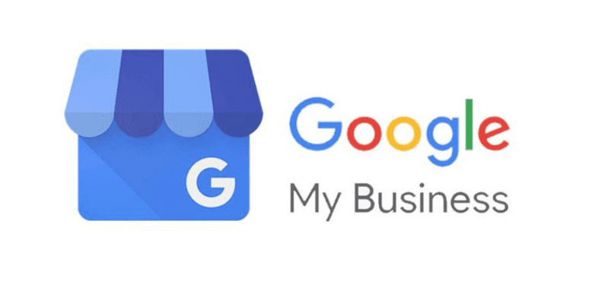
Tools That Measure Your Website Traffic
GOOGLE ANALYTICS
GOOGLE SEARCH CONSOLE
GOOGLE MY BUSINESS
*When using these tools, make sure to include a cookie popup to be GDPR compliant, I’ll share one I love in my resources section.

Slide 34
How to Use Google Analytics
Track Website Performance and Goal Completions
Measure What is Your Most Popular Website Content
Identify and Improve Under-Performing Content
Understand Where Your Website Traffic Came From

Slide 35

How to Use Google Search Console
Shows Google How to Access Your Content
See Which Content is the Most Visible on Google
Get Alerted When Website Content is Hurting your SEO and Why

Slide 36
How to Use Google My Business
Focuses on Local SEO Visibility
Lets People Know Your Business Location and Hours
Shares Your Contact Information and Company Details

Slide 37
Cool Stuff You Can Use

Slide 38


Google Site Kit WordPress Plugin
Makes adding and managing your Google tracking platforms within WordPress a breeze!
It’ll add your tracking to your website site-wide with just a few clicks, no fumbling around in HTML headers and footers for us! I mean, unless that’s something you like to do… Then go for it!
Get Started Here:

Slide 39


Yoast SEO WordPress Plugin
Yoast SEO’s Free Plugin makes SEO even easier on WordPress.
It’ll do the following to help your SEO:
Creates your website sitemap you can link directly into Google Search Console
Update pages and blog post’s preview data on social media (known as “metadata”)
Learn More:

Slide 40
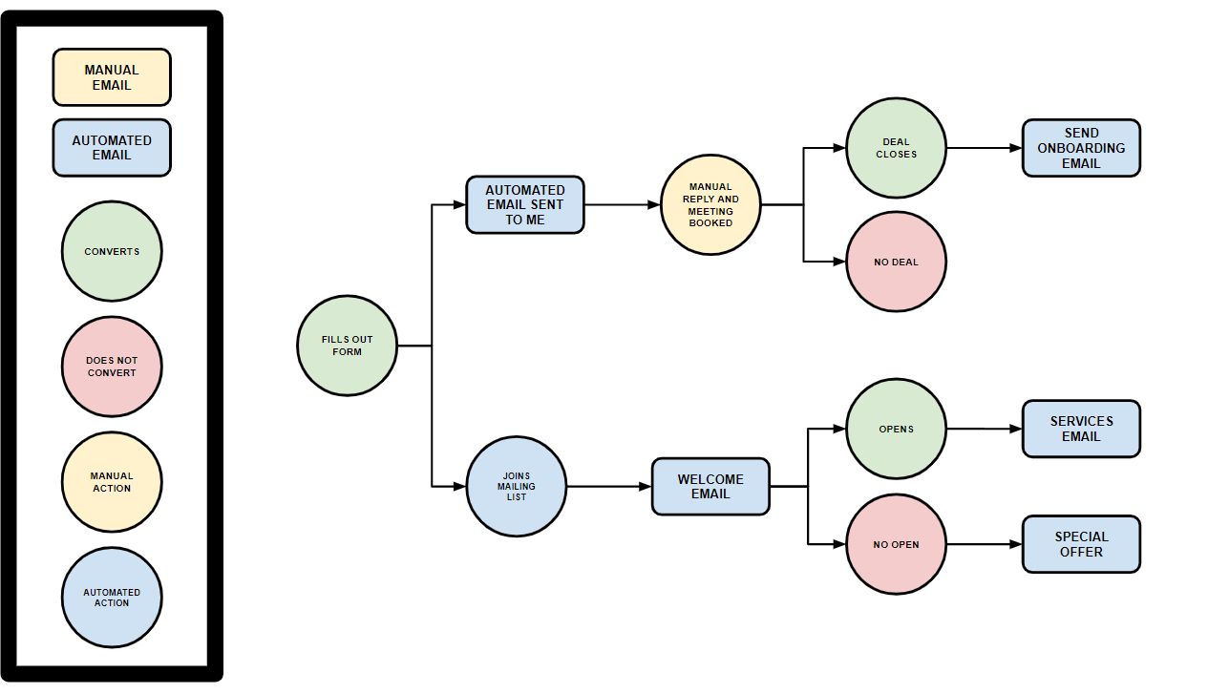


Google Drawings Email Marketing Flowchart Template!!!
DOWNLOAD TEMPLATE:
SCAN FOR RICK ROLL:
Notes:
I CREATED A HANDY DIAGRAM THAT HELPS ME MAP OUT THE SEQUENCE OF ACTIONS THAT TRIGGER AUTOMATED EMAILS,
AND GENERALLY I FIND THIS REALLY USEFEUL FOR PLANNING WHERE TO GROW FUTURE CAMPAIGNS AND HOW THEY INTERACT
WITH OTHER EMAILS I’LL BE SENDING OUT.
IT’S A LOT TO BALANCE TO MAKE SURE AUTOMATION WON’T OVERLAP WITH OTHER CAMPAIGNS AND OVERWHELM SUBSCRIBERS.

Slide 41


SEO Site Checkup
Use this for a quick-and-easy shopping list of SEO improvements for your website.
This website offers really specific information on what needs fixing + why it’s an issue, too! Try it Out Here:

Slide 42


CookieYes | GDPR Cookie WordPress Plugin
Avoid breaching GDPR by confirming your consent to use cookies with people on your website.
This plugin makes life a lot easier by blocking cookies until users accept. There’s many more options available of similar plugins, see which one you like the most!

Slide 43


How Do I Manage all this Social Content?
I recommend using HootSuite’s free plan for scheduling your social promotions with ease. You’ll be able to track at-a-glance what you’ve talked about, track post creation progress, and collaborate on post content (maximum 1 user/account).
For plans outside of the free plan, you’ll get access to more advanced features to help you in post creation even more, but the free plan is a great place to start. GET STARTED HERE:

Slide 44


It’s Dangerous to go Alone… Take a Banner!
Designed banners should be eye-catching enough to stop anyone “Doom Scrolling” on their social media feed and go back for a second look. Those first milliseconds of deciding if a post is worthwhile aren’t defined by your copy—but by the image you use.
With that said, every post you create should include a banner. If you’re light on design options, Canva offers some great resources on their free plan for banner design, letting you work within their templates to create something custom to you. You can even upload assets into Canva! GET ACCESS TO CANVA:

Slide 45


Love Dashboards?
I love DashThis as a not-so-savvy Power BI user, and they offer a 15-day free trial!
They make tracking your website, social media, website, and email marketing metrics easy, and they have lots of awesome templates that cover key metrics you should be looking at. GET STARTED HERE:
Plus they have the best logo ever…

Slide 46

Download My Slides & Resources!
← Just Scan This QR Code for my Google Drive Folder!
Even more great resources are available from Paper Sword B2B here:
paperswordb2b.com/marketing-resource-package/

Slide 47

Thank You, New Stars of Data Team & Volunteers!

Slide 48
Questions or Feedback? Let’s connect!
Jeremy Alexander
Email: Jeremy@paperswordb2b.com
LinkedIn: linkedin.com/in/jerroalexander Home Address: 123 Fake Street

